Slide 1
Selections Images
Evergreen 36

Slide 2
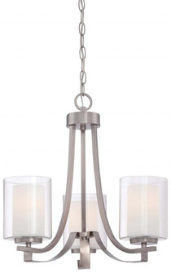
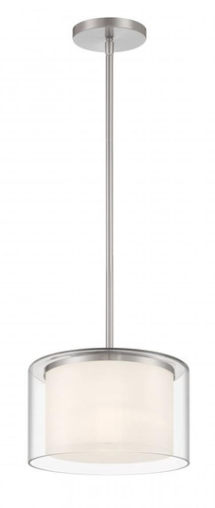
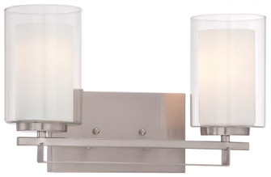
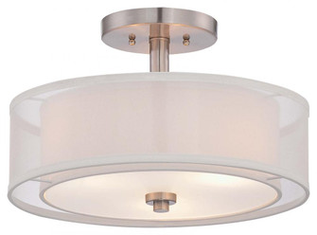
LIGHTING
Bath Lights
Wafer Lights
Dining Room
Pendant Lights
Semi Flush

Slide 3
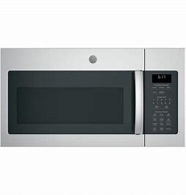
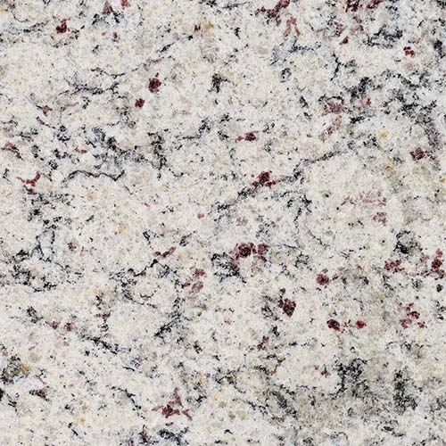
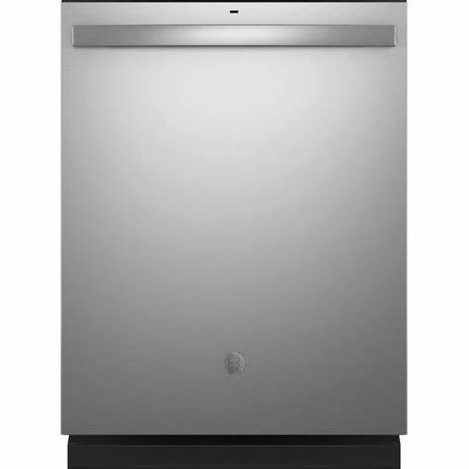
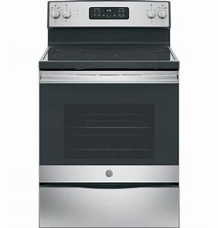
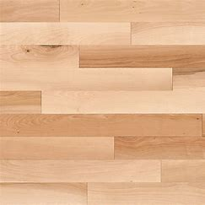
KITCHEN
Kitchen Sink
Appliances
SF Real Granite
Chai Latte Cabinets
Hardware
Birch Hardwood

Slide 4
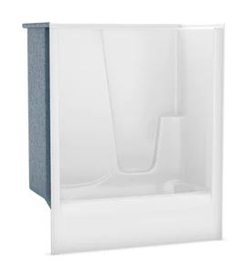
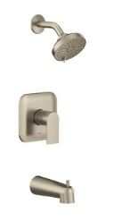
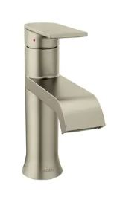
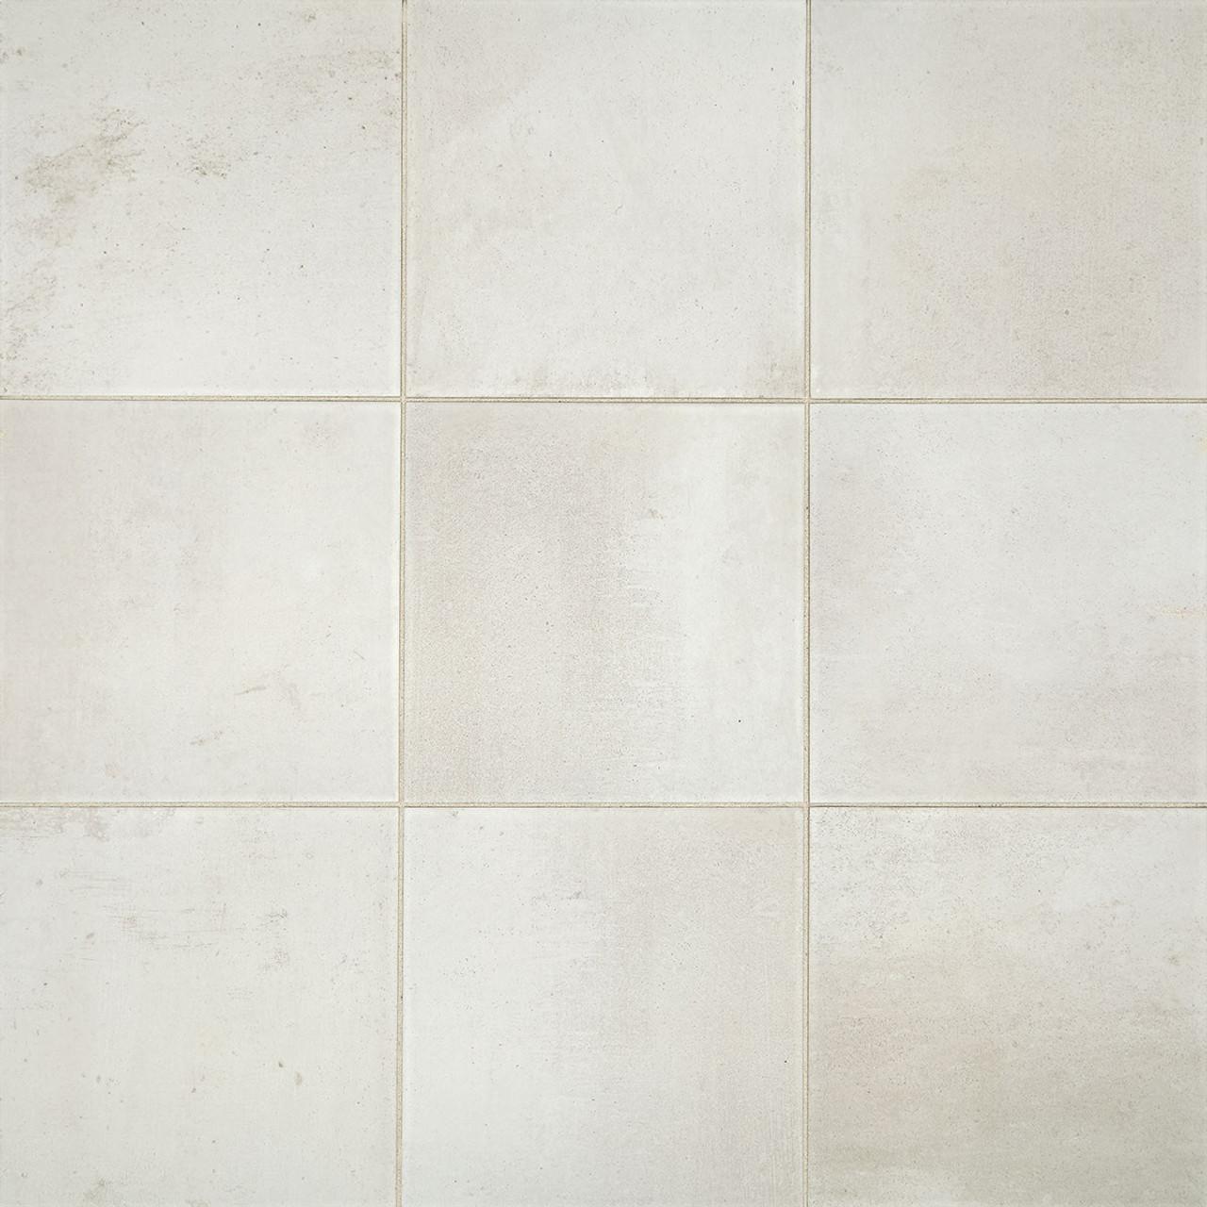
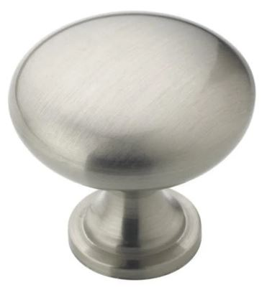
FULL BATH
Tub Shower Insert
SF Real Granite
Genta Faucet
Genta Shower
Trim
Chai Latte Cabinets
Hardware
Modern Hearth Flooring

Slide 5
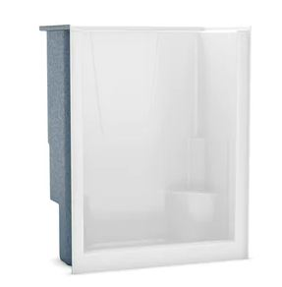
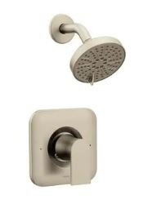
MASTER BATH
Shower Insert
SF Real Granite
Genta Faucet
Genta Shower
Trim
Chai Latte Cabinets
Hardware
Modern Hearth Flooring

Slide 6
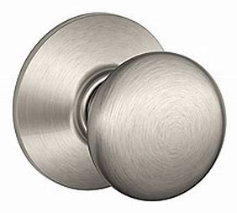
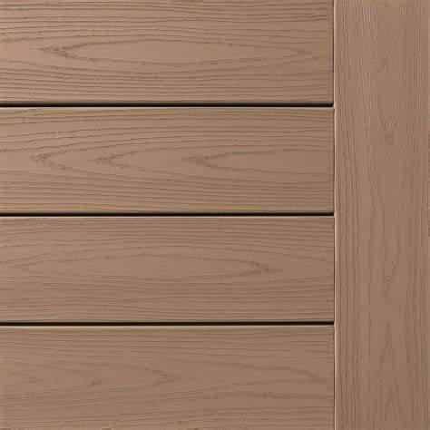
OTHER
Birch Hardwood
Satin Nickel Hardware
Cream and Sugar Front Door
Agreeable Grey Interior Paint
Brownstone Decking
Forest Siding
Winslow Doors

